Slide 1
Good Observing in Constrained Curcumstances
Joan and David Dunham

Slide 2
COVID-19
Limited travel
Loss of access to good sites
Big and heavy telescope
Trees
Streetlights
Traffic
City light dome
Bad summer observing weather
Whatchu gonna do?
Whatchu gonna do?

Slide 3
Observing Occultations While Sheltering in Place
Suggestions
Use prepoint line to locate accessible spots where the target will be visible
If the location is very public, have an assistant ready to answer curious people who want to ask what you are doing
Examples
Sidewalk
Driveway
Under a streetlight
Through an open upstairs window
Anyplace safely accessible with with a view of the event

Slide 4
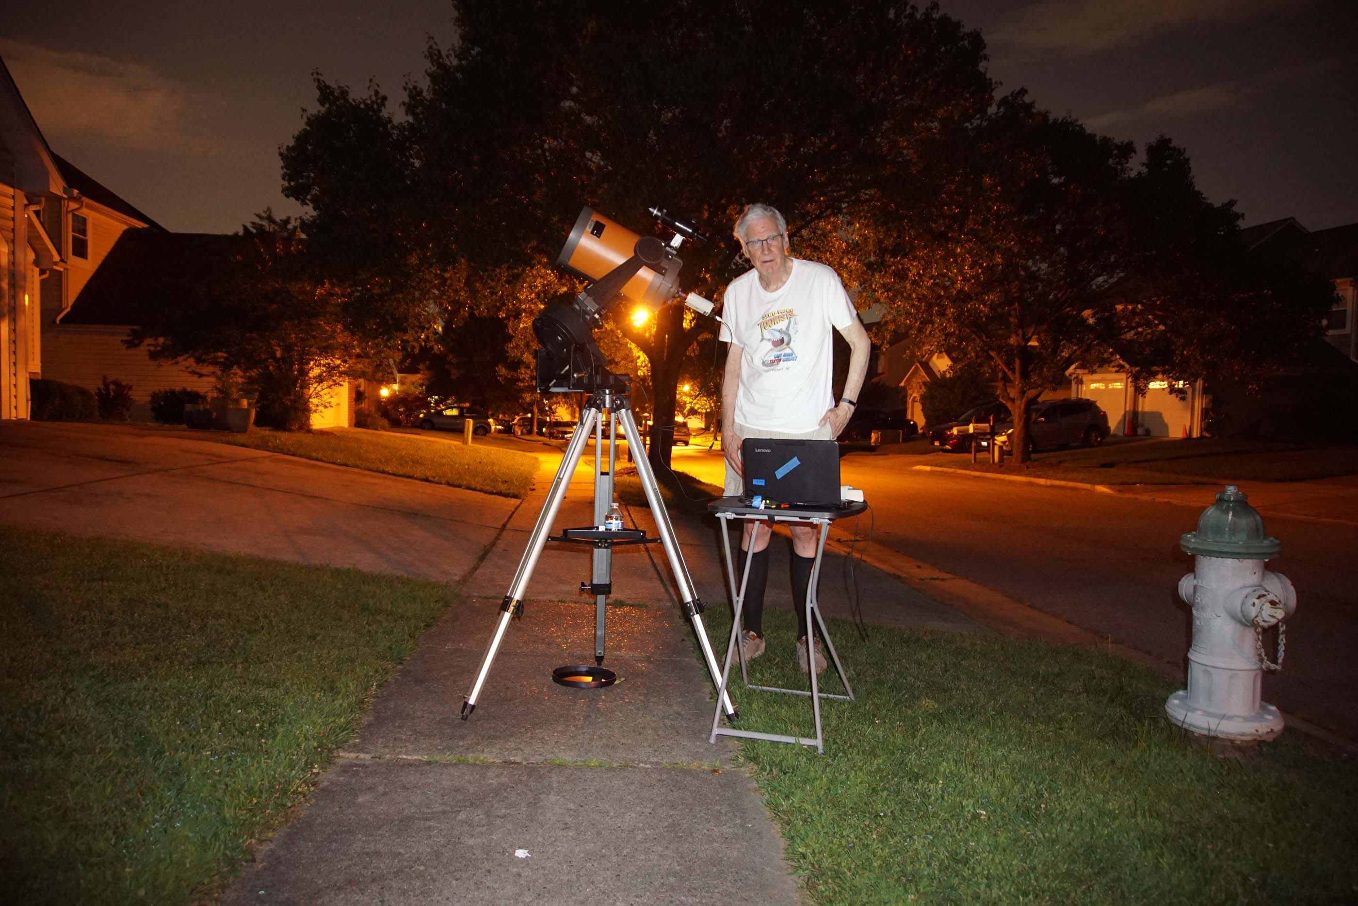
Sidewalk Observing 1
Successfully timed lunar occultations by a gibbous Moon, 7/4/2020.
Scope is an elderly C8 given to us by Wayne Warren when he moved to Florida.
Streetlight →

Slide 5
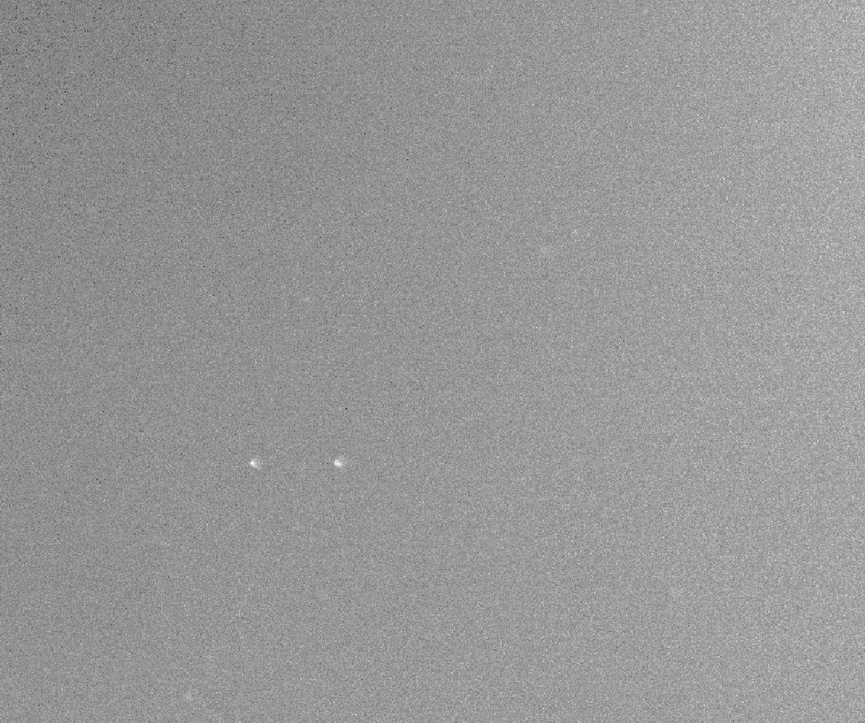
Sidewalk Observing 2
Skywatcher 16 + QHY 174 GPS camera from various locations on the sidewalk recording occultations by
Kalypso – 7/3/2020 (miss)
Picka – 6/1/2020 (miss)
2013 LU28 – 6/2/2020 (miss)
Tsiphone – 7/2/2020 failed
From the Tsiphone attempt, a mag 13.8 star + a 13.7 asteroid observed from underneath a streetlight. We failed to find the target on time, but the star + asteroid was detectable on the recording (albeit not easily). The arrow points to the pair after the predicted event time.

Slide 6
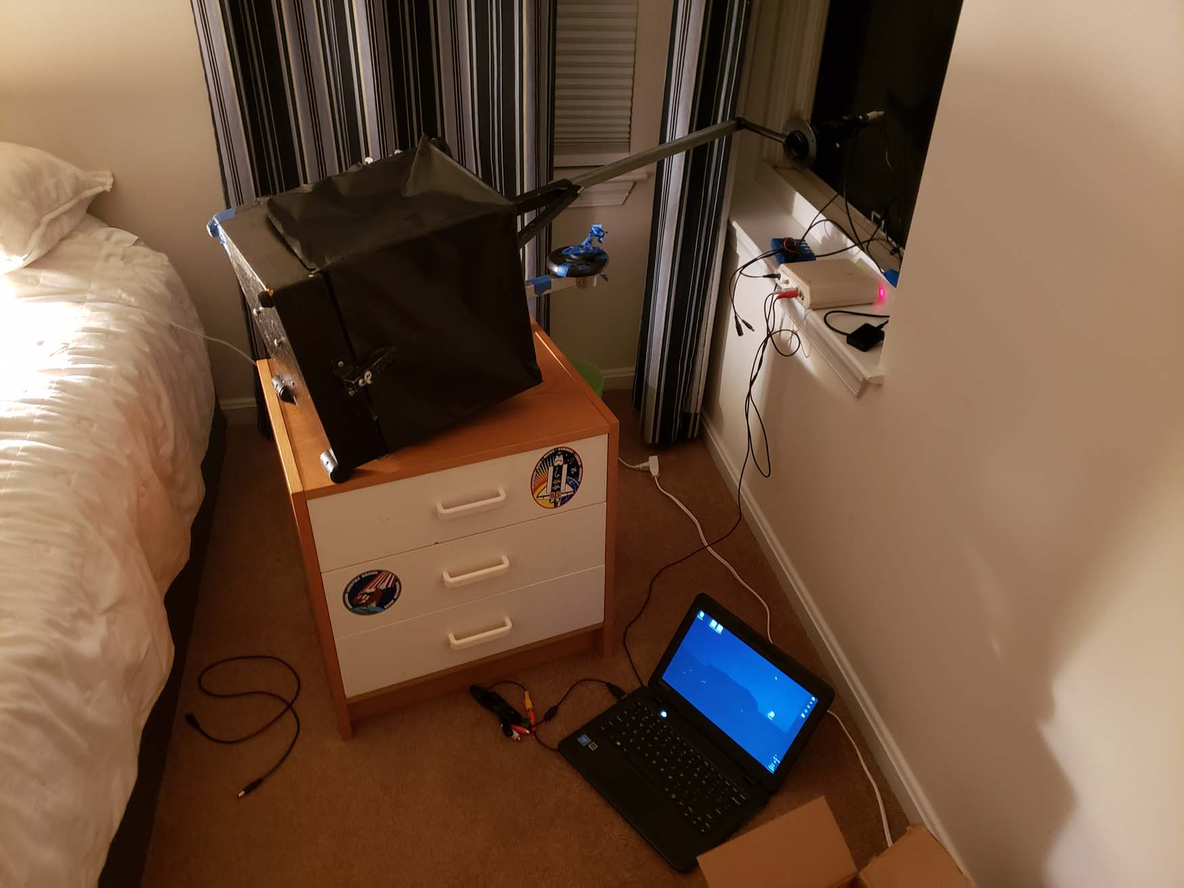
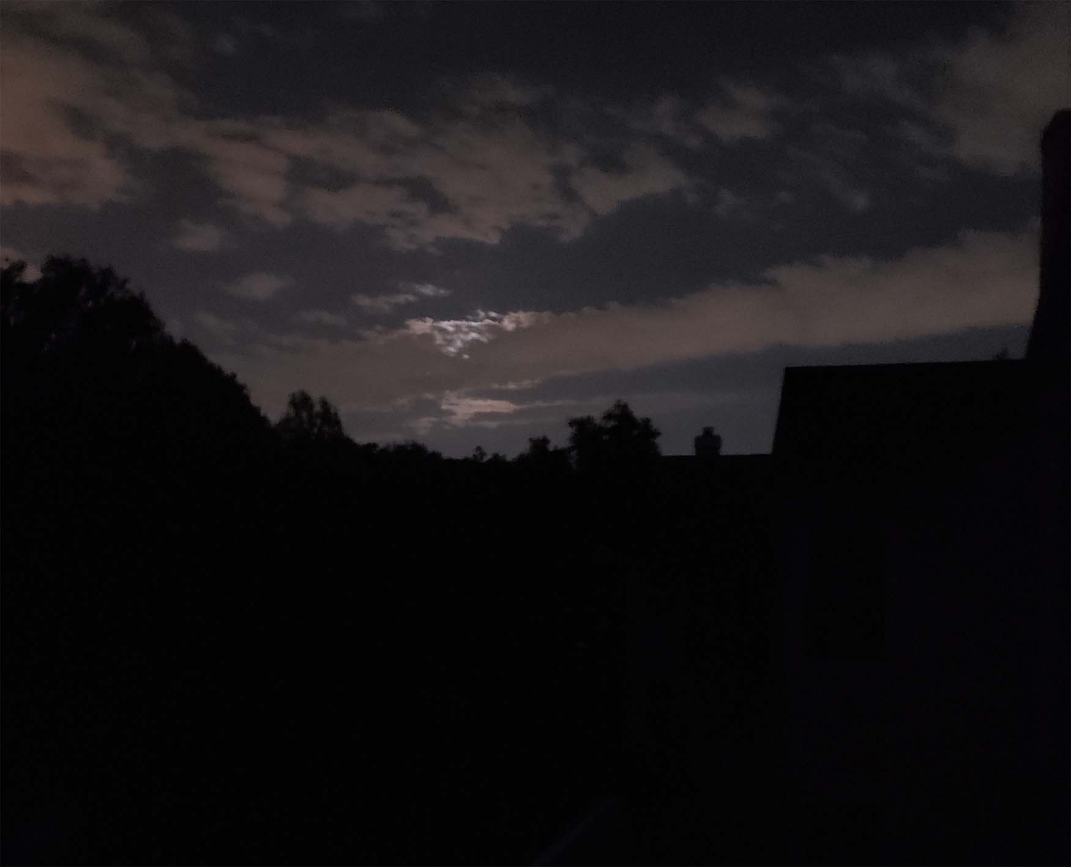
Lunar Occultations from a Window
Observing from a bedroom window on 5/31/2020
But a cloud obscured the occultation of nu Virginis by the Moon

